Slide 1


DARE-NGS: Scalable and Extensible NGS Analytics on High-Performance and Distributed CI
Joohyun Kim, Sharath Maddineni, Shantenu Jha
and
Christopher Gissendanner Department of Biology, University of Louisiana at Monroe
http://dare.cct.lsu.edu/ and http://saga.cct.lsu.edu
Notes:
Added slide 3
I think there will not be time to focus on “assertion based” approach, i.e slides 4-7. Possibly include slide 8

Slide 2
Overview
Part I: DARE-based Gateways
The Case for Advanced NGS Data Analytics
CI/HPDC challenges for NGS?
GW: Effective integration and utilization of HPDC CI
Scalability – Applications, People and Resources
DARE-NGS: Integrating GW-HPDC for NGS-Analytics
What is DARE?
“NGS Analytics as a service”
DARE-HTHP: Power of Abstractions!!
Part II: Collaborative Science-CI development [Chris]
Part III: DARE-NGS Demo [Sharath]
Roadmap and Discussions

Slide 3
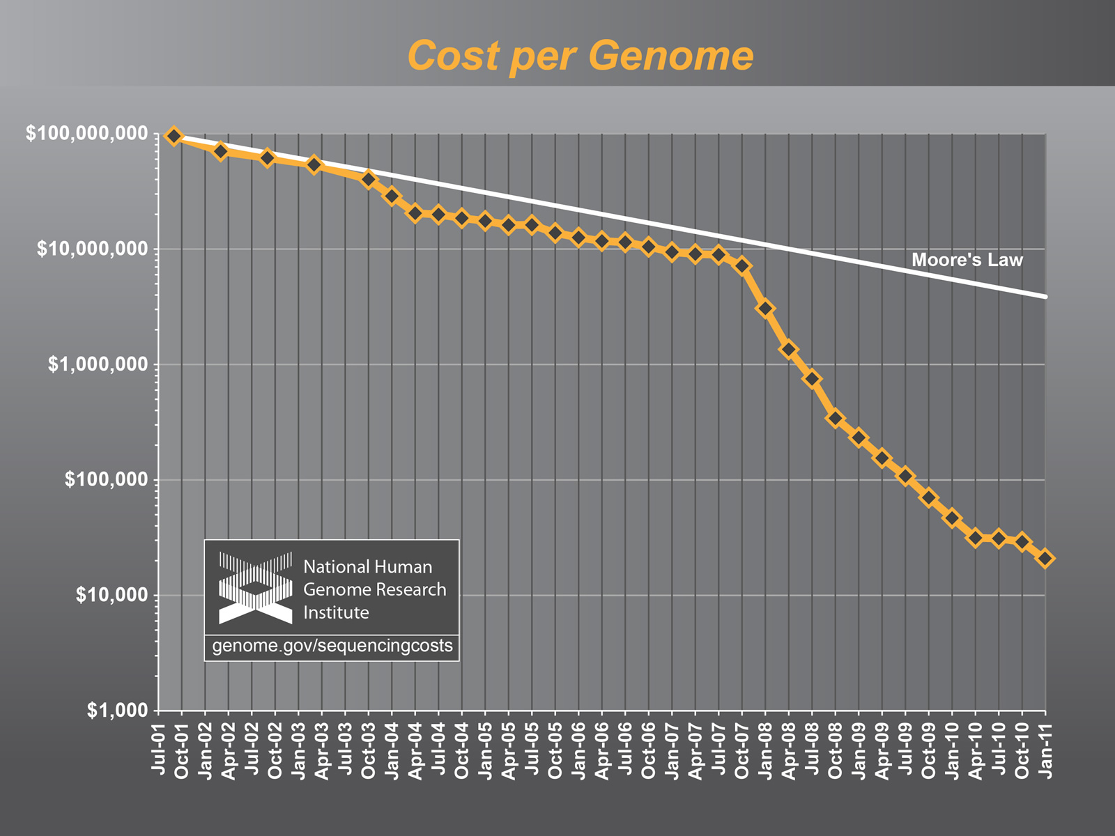
The case for Advanced, Scalable and Extensible NGS Analytics
“There is a growing gap between the generation of massively parallel
sequencing output and the ability to process and analyze the resulting data. New users are left to navigate a bewildering maze of base calling, alignment, assembly and analysis tools with often incomplete documentation and no idea how to compare and validate their outputs. Bridging this gap is essential, or the coveted $1,000
genome will come with a $20,000 analysis price tag."

Slide 4
CI/HPDC Challenges for NGS Analytics
What is the optimal cyber-infrastructure configuration?
No well-defined single infrastructure configuration or capabilities
Distinguish: Astronomy, HEP community
Integrated Compute and Data CI at unprecedented scales
“Building this infrastructure is not trivial” (Fox)
Need both Development and System/Infrastructure level abstractions
There are “hard” parts and tractable parts
Use of standards and middleware integrated with resources handles the hard part, opening up innovation elsewhere
“Clouds are the natural CI for NGS” !?
Data localization model scalable? sustainable?
How and when to move compute to data (or vice-versa)?
What are the data transfer/access/storage mechanisms

Slide 5
The case for Gateways and HPDC
Observation I
Using local compute resources and data storage is too limited.
Observation II
Users need a pathway from local to National CI
Need for Campus Bridging
Observation III
Using Supercomputers or HPC resources is difficult and complex
Gateways: “Community-based” Solution
“Expert” configure, optimize once: Multiple users/usage
Hiding the complexity of using distributed HPC resources and emerging cloud environment.
Gateways: fastest growing access mode/mechanism on XSEDE

Slide 6
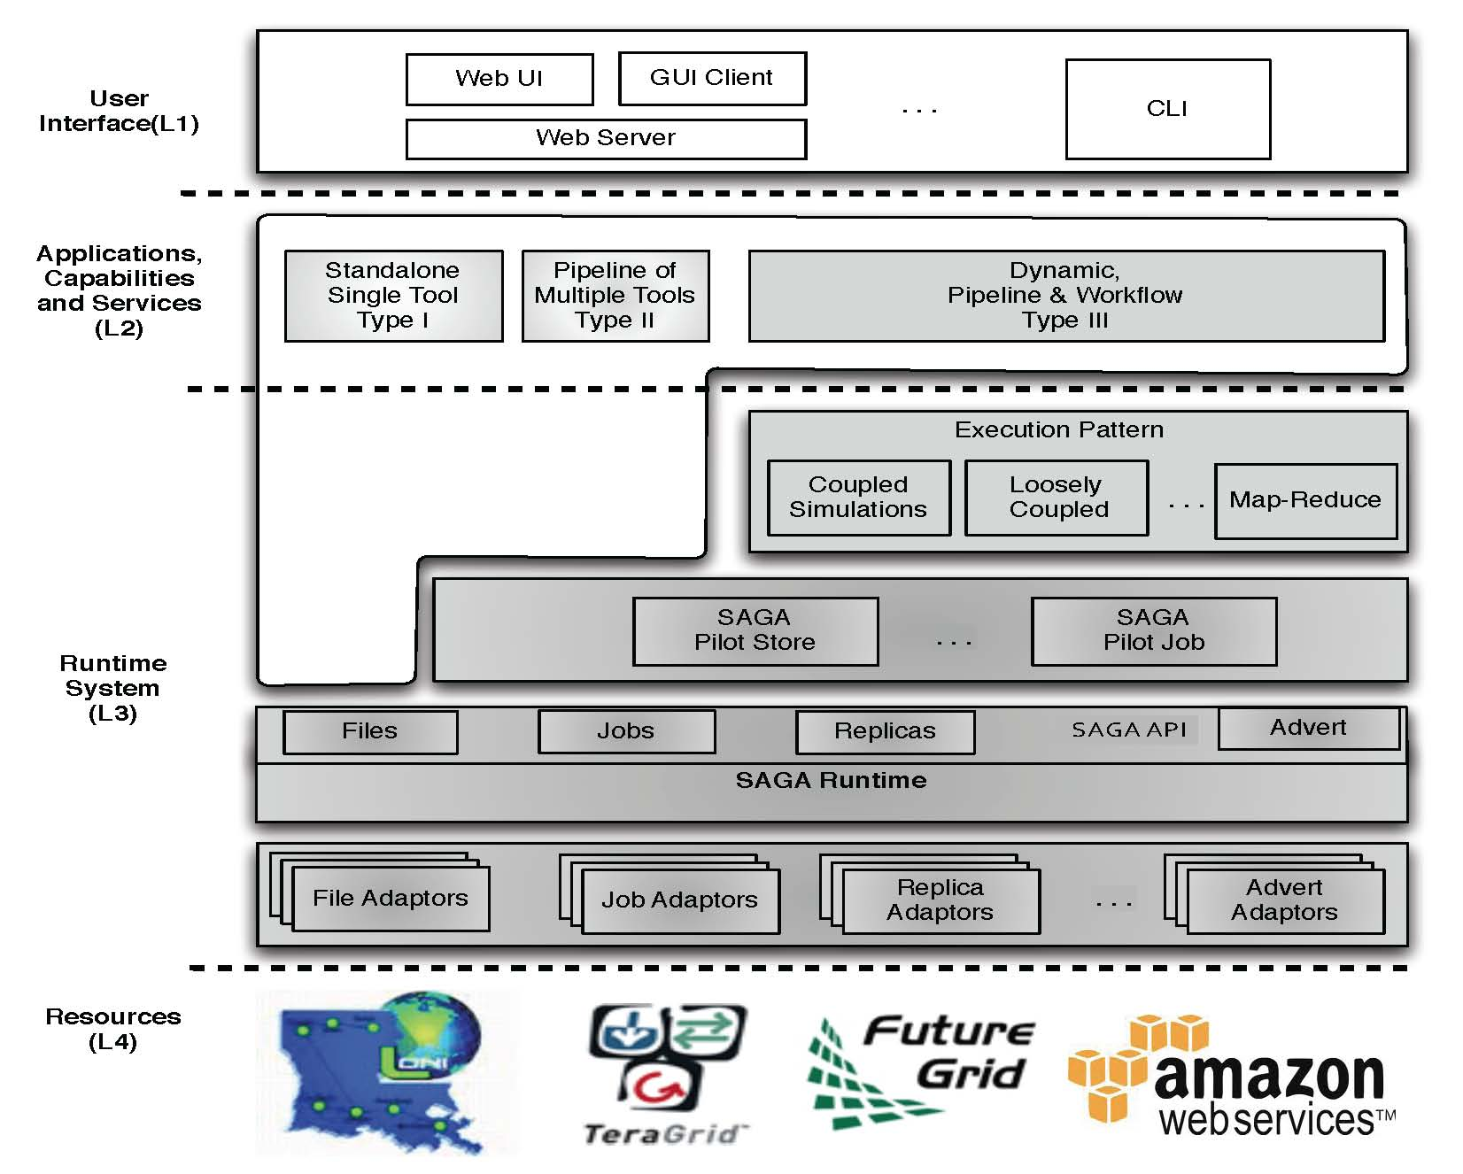
DARE-based Science Gateways (I)
Three levels:
Access/Application Layer
Services & MW Layer
Resource Layer
Application/Access Layer
Extensible and flexible
Standard-based middleware and services
OGF Standard and official access layer of NSF XSEDE
Resource Level
Extensible + Interop
Notes:
Fixed the diagram.. Please remove next slide if you are OK with this

Slide 7
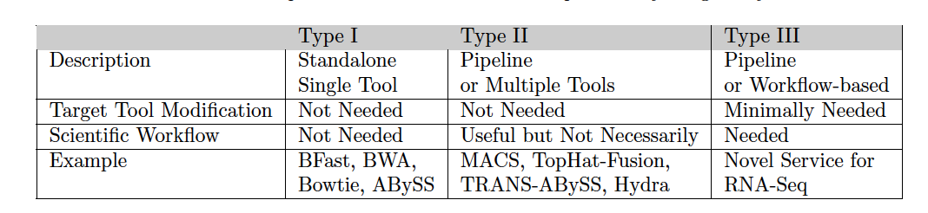
DARE-NGS : Service Types
Notes:
This will be very hard to read!

Slide 8
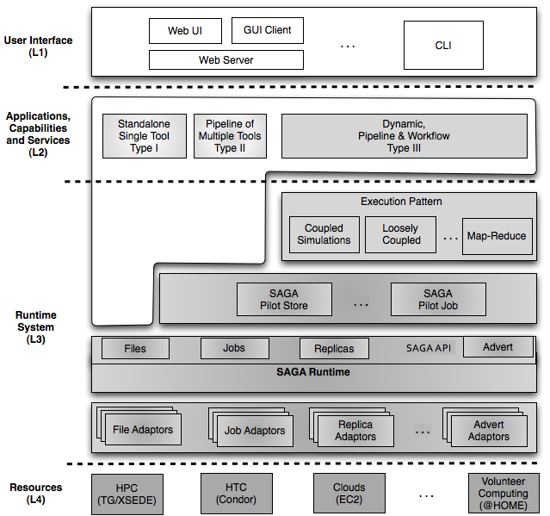
DARE-based NGS Gateways (II)
NGS is a good science application for Gateways
Plethora of tools, integration needs etc.
Complex compute-data requirements
Extensible Frameworks, Tools and Services
Vertical & Horizonatal Integration
Integrated compute and data abstractions
Interoperable across DCI
Notes:
Fixed the diagram.. Please remove next slide if you are OK with this

Slide 9
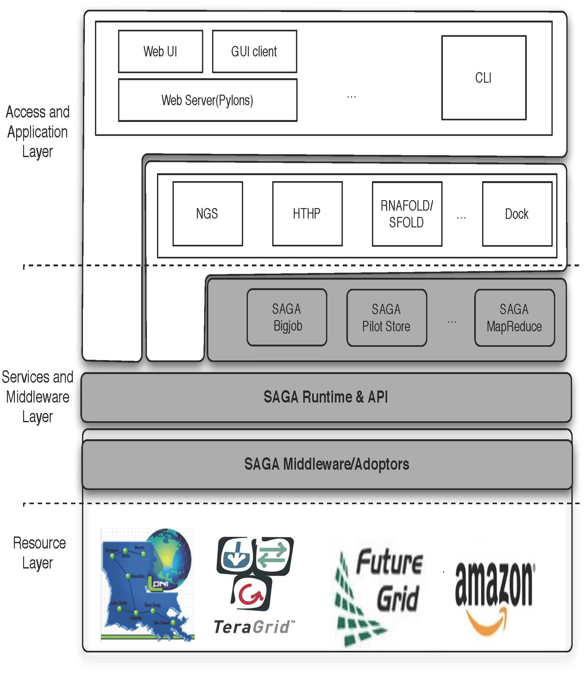
DARE-based Gateway: NGS Analytics as a Service
Some NGS specific challenges
Efficient Algorithm/tool/code selection
Hosting pre-installed VM
Efficient task scheduling and placement
Efficient Distributed data management
Efficient Data transfer/scheduling
Transfer of Ref. genome index files:
O(hours) 130 GB,
Transfer of Short read files:
O(mins) [L to QB] 9 GB
Determine optimal point -- tradeoff
http://dare.cct.lsu.edu/gateways/ngs

Slide 10
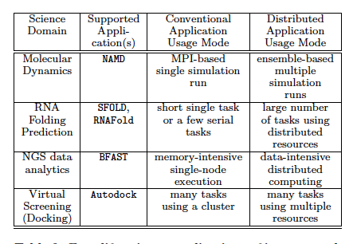
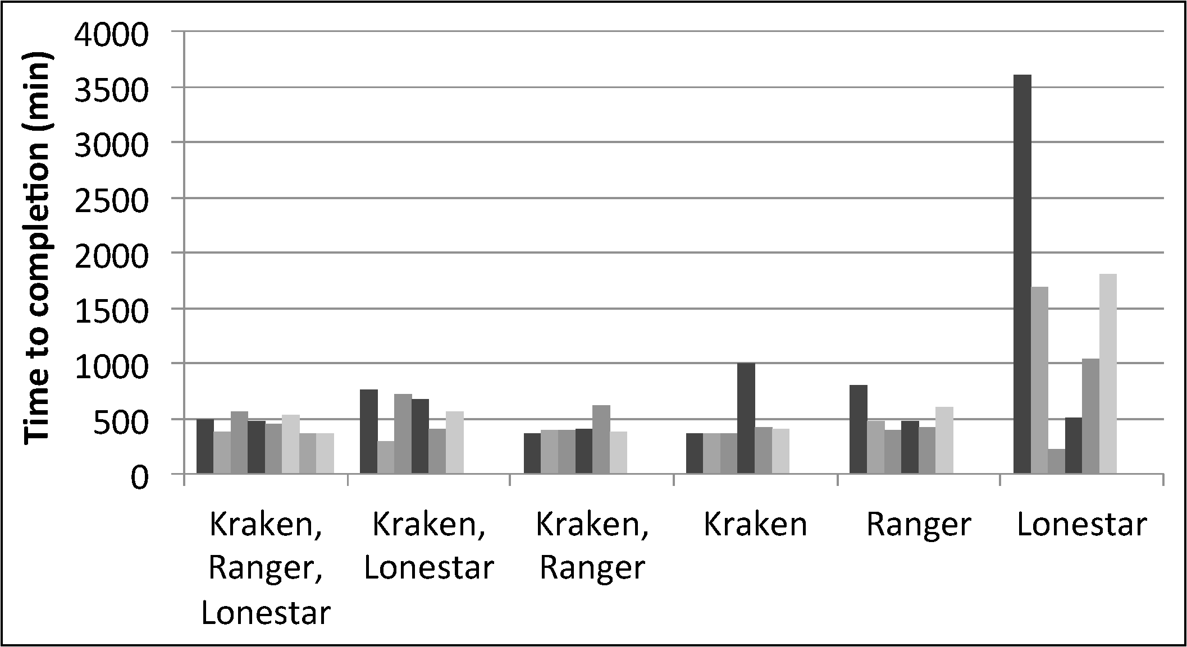
DARE-HTHP: Power of Abstractions
Work with Tom Bishop (La Tech) et al

Slide 11
DARE-NGS : NGS-Analytics and Downstream Analyses
Overview - Computational/Bioinformatics Strategies for Genomic Data Analysis
WGS, CHIP-Seq, RNA-Seq:
Billions Short Reads
Mapping
De Novo Assembly
Whole Genome Analysis (WGS)
Exome Analysis
Transcriptome Analysis
(RNA-seq)
Genome-wide DNA-protein interactions
(ChIP-seq)
Functional Genomics, Gene Regulation, Pathway Analysis – Cell Development & Differentiation, Host-Pathogen interaction, Biomedical research
Notes:
SJ: Color coding is a bit misleading. Does purple (right sight, lower level) represent analysis? If so, be sure to say so

Slide 12
DARE-NGS : Scientific Collaborative Development
RNA-Seq : Transcriptome Analysis of Burkitt’s Lymphoma cells and lincRNAs Discovery (Tulane U)
Exome : Large Scale Human Exome (PBRC)
DARE-NGS : NGS Data Analysis Gateway Development
Genome-wide Transcription Factor Binding : ULM
Host-Pathogen Interaction (Rice-B. Glumae) : LSU, AgCenter
Notes:
SJ: Something more structured than this is preferable. I still think this is getting too long. There will be other people talking about NGS and we will be the last
To talk about NGS, so a lot of this will be covered. We should give no more than 3-5min motivation.

Slide 13
DARE-NGS : Scientific Collaborative Development
Transcriptome Analysis of Burkitt’s Lymphoma cells and lincRNAs Discovery
PI : Erik Flamington (Tulane U)/Carl (Tulane GCF)
Focus : RNA-Seq using Tophat/Cufflink, Tophat-fusion
Exome Analysis
PI : Tuomo Rankinen (HGL, PBRC)/PBRC GCF
Focus : Large Scale Mapping and Genome Variation Discovery
Genome-wide (C. elegans) Transcription Factor (NHR-6) Binding
PI : Chris Gissendanner (ULM) (LBRN PI)
Focus : ChIP-seq Pipeline Development
Rice-B.Glumae (Host-Pathogen)
PI : Jong-hyun Ham (AgCener, LSU)
Focus : Host-pathogen Interaction using RNA-Seq, Integrative Infrastructure for Drug Discovery targeting Quorum-Sensing Mechanism
Notes:
SJ: Something more structured than this is preferable. I still think this is getting too long. There will be other people talking about NGS and we will be the last
To talk about NGS, so a lot of this will be covered. We should give no more than 3-5min motivation.

Slide 14
ChIP-seq analysis of the NR4A nuclear receptor transcription factor in C. elegans
Chris R. Gissendanner, Ph.D.
Dept. of Basic Pharmaceutical Sciences
ULM College of Pharmacy

Slide 15
Project Background
Focus of INBRE project is to determine the cellular mechanisms of NR4A NR activity during organogenesis in C. elegans
NHR-6 is the C. elegans NR4A nuclear receptor ortholog
Hypothesis: NHR-6 has dualistic functions in regulating cell proliferation and cell differentiation and that these activities are regulated through differential interactions with signal transduction pathways
One test of this hypothesis is to identify NHR-6 target genes
What are the target genes regulated by NHR-6 during distinct stages of organ development?
Are there distinct sets of target genes regulated by NHR-6 during the cell proliferation and cell differentiation stages of organ development?

Slide 16
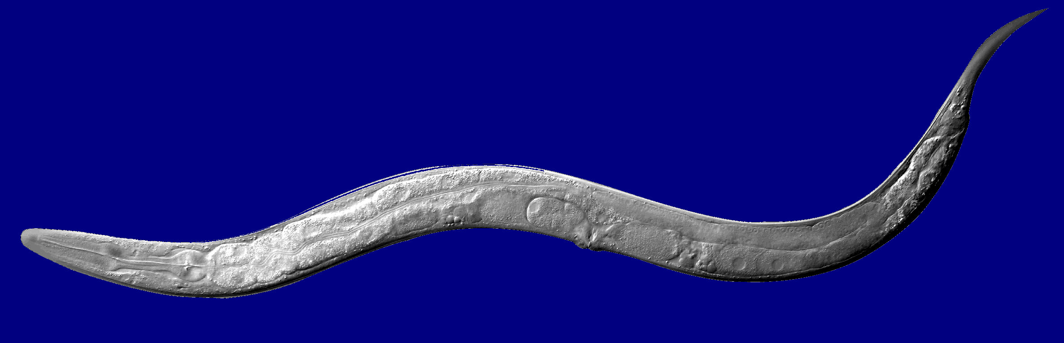
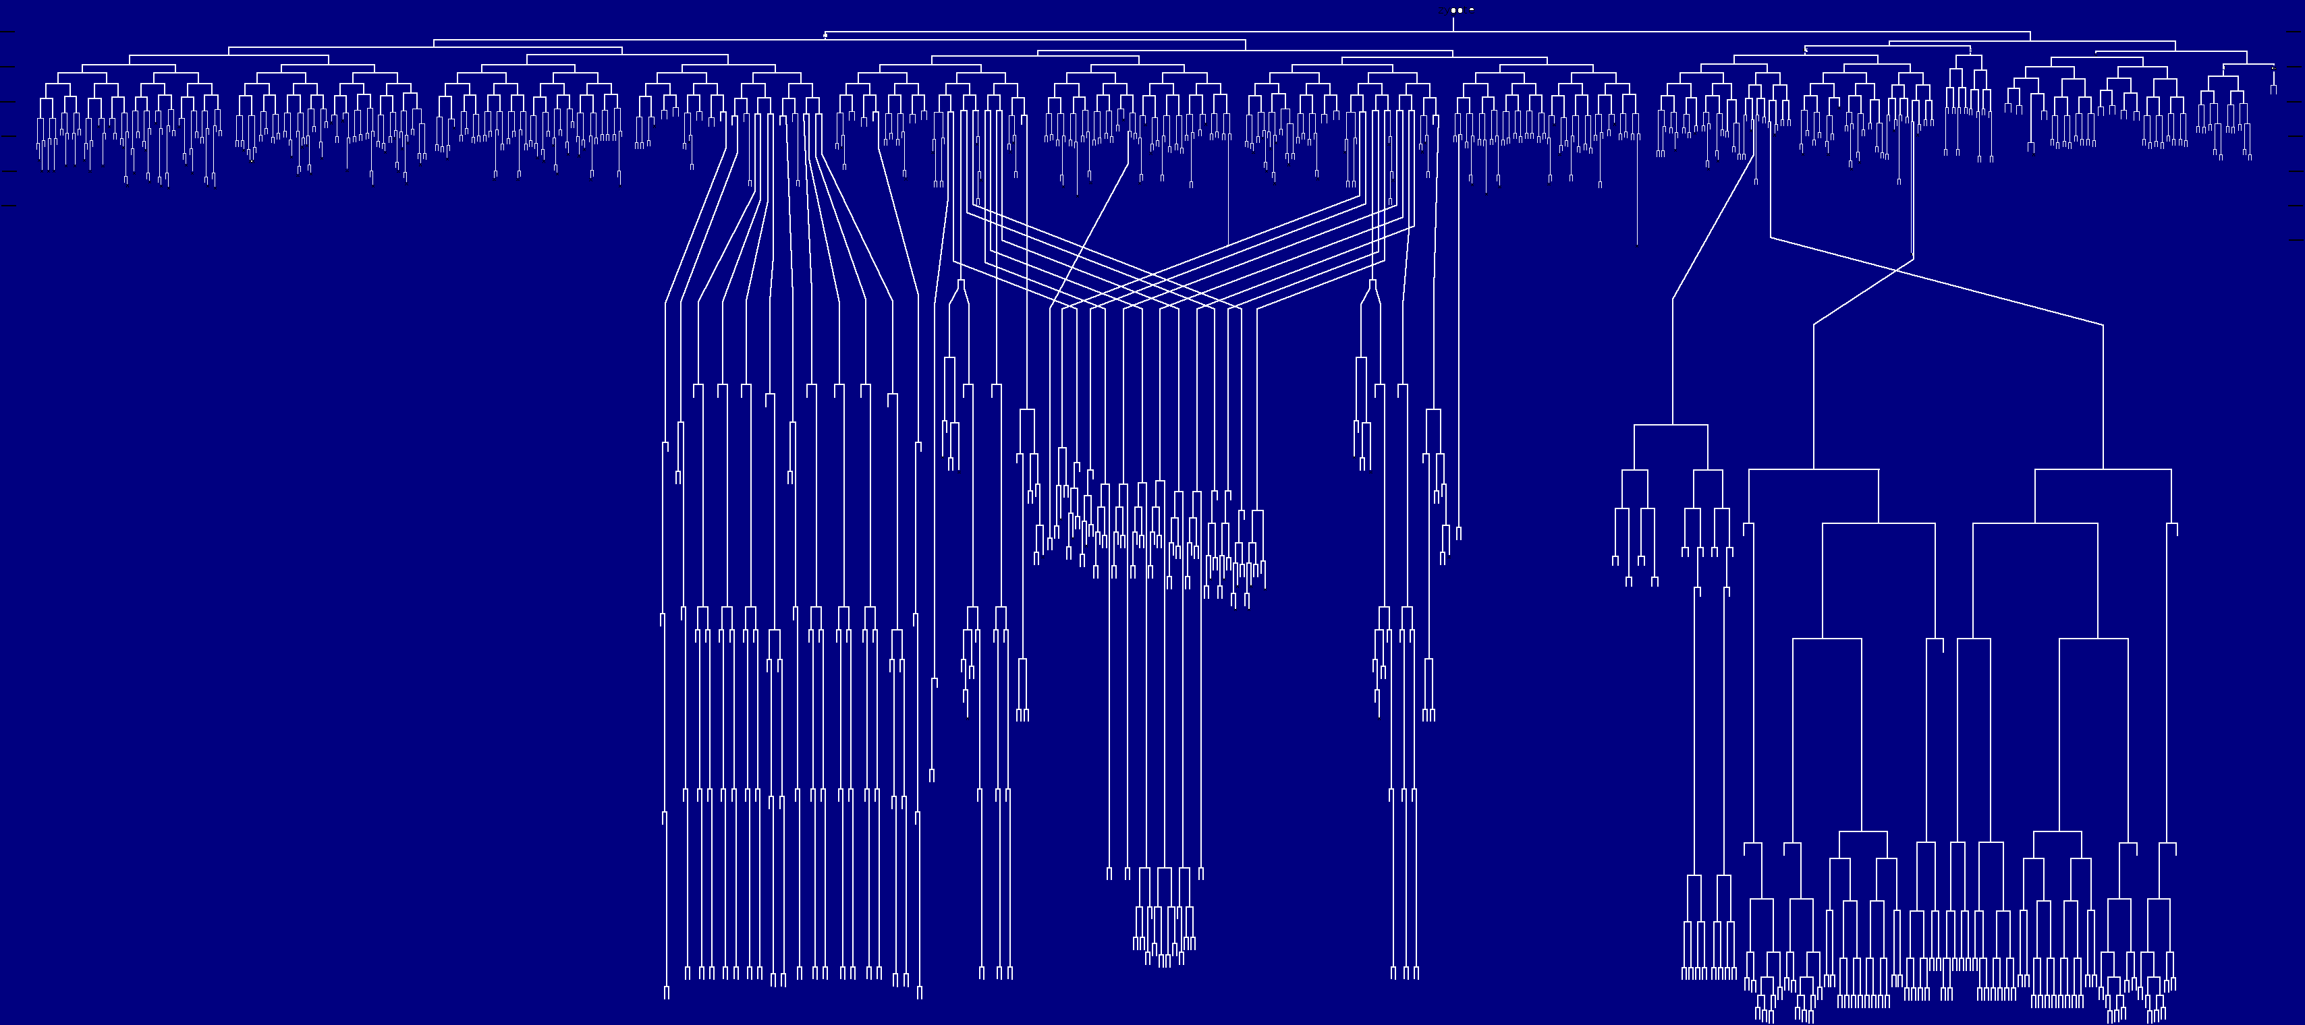
Caenorhabditis elegans: invariant cell lineage
Notes:
16

Slide 17
ChIP-seq: rationale and approach
ChIP-seq is a robust, unbiased approach to identifying candidate transcription factor target genes
Our experimental system is also well-suited to using this approach
1) NHR-6 is not broadly expressed (restricted to a specific organ primordium and a few neurons) → for our whole-animal approach most target genes will have relevance to the developmental process we are studying
2) We have shown that GFP-tagged NHR-6 is fully functional in vivo using genetic rescue assays
Reliable GFP antibodies
3) Concurrent study using microarray analysis of tissue-specific isolated mRNAs
Correlate ChIP-seq data to gene expression data

Slide 18
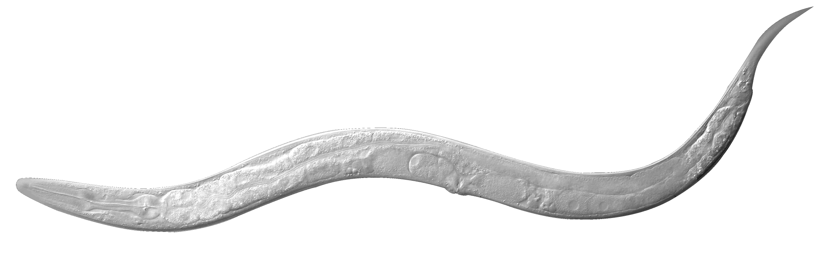
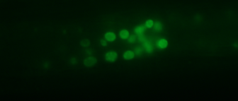
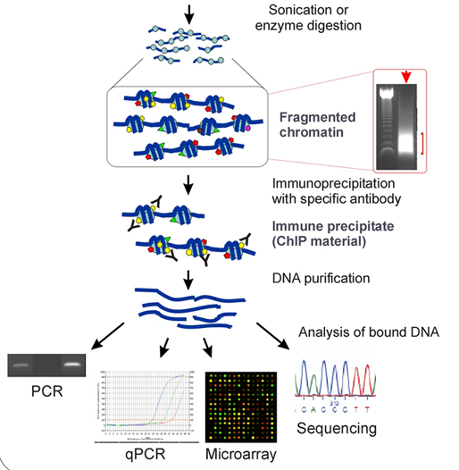
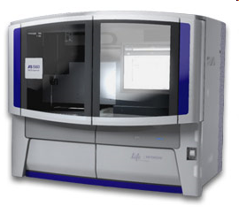
Experimental Approach: Whole animal ChIP-seq
Cross-link NHR-6::GFP to DNA in vivo
animal lysis
Next-Generation Sequencing followed by bioinformatic analyses

Slide 19
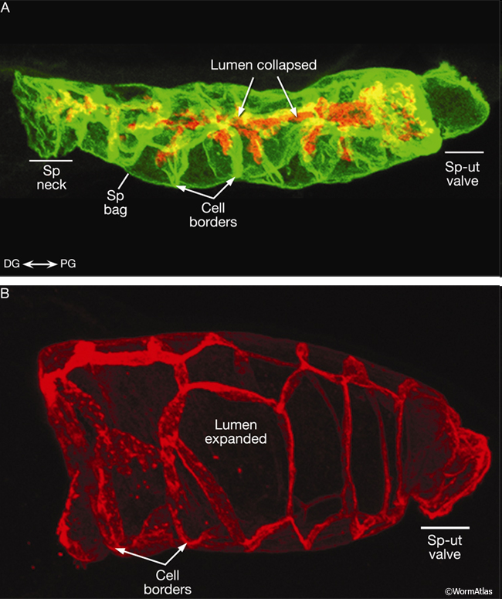
Spermatheca organ system

Slide 20
Plan
Optimize ChIP conditions (sonication and IP)
Time course experiment → two developmental stages
Late L3/early L4 and mid/late L4 stages
8-sample run: sequence two biological replicate IP DNAs at each stage plus input for each replicate
Sequence ChIP DNA at Pennington Genomics Core Facility (SOLiD system)
Collaborate with Dr. Joohyun Kim at LSU CCT (INBRE Bioinformatics Core) for computational analysis

Slide 21
Collaboration with LSU CCT
Analysis of ChIP-seq data
1) Sequence reads need to be mapped to a reference genome
2) Peak calling algorithms utilized to identify peak regions at different levels of statistical significance
3) Downstream analysis: gene calls, motif search, gene ontology

Slide 22
Collaboration progress to date
Analysis of modEncode data
Data for NHR-6 available for public download
Raw data fastq files
C-terminal GFP fusion
L2 stage (NOT the developmental stage of interest)
Illumina sequencing followed by ELAND mapping and Peakseq peak calling algorithm
Data set we could use immediately to test mapping programs and peak calling algorithms
Compare peak calling results to modEncode Peakseq results
Comparison of data at two developmental stages (one stage when the organ formation process is occurring and the other when it is not)

Slide 23
Collaboration progress to date
M.S. student Rashika Rangaraj performed an INBRE summer research project with Dr. Kim
Developed an initial analysis pipeline of the modEncode data
mapping, peak calling (MACS), and visualization with UCSC Genome Browser
MACS vs. Peakseq comparisons
MEME analysis on MACS and Peakseq peaks

Slide 24
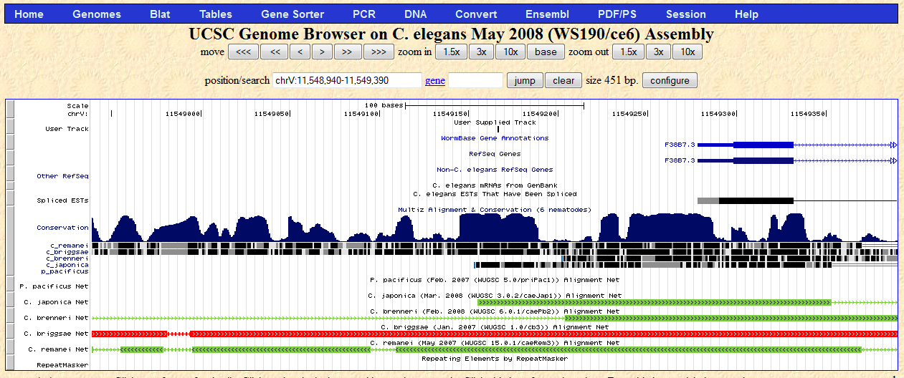
The Red arrow indicates the location of the summit of the MACS peak : Chr V: 11548940-11549390

Slide 25
Some things we have learned…
Different mapping and peak calling algorithms give different results
# of peaks called; peak boundaries
The latter can be critical in running downstream analyses (e.g. MEME)
Multiple mapping and peak calling algorithms likely to be useful
Sequencing platforms (SOLiD and Illumina) have analysis pipelines (LifeScope is the pipeline for SOLiD)
DARE will provide options for additional mapping and peak calling in addition to the platform pipeline

Slide 26
Comparing # MACS peaks for Chromosomes I - V
with FDR≤ 40%
Total # MACS peaks: BWA= 56, Bowtie= 57
FDR% | BWA | Bowtie
0 | 8 | 7
0-5 | 6 | 1
5-10 | 5 | 2
10-20 | 5 | 10
20-40 | 32 | 37
# MACS peaks
FDR %

Slide 27
Comparing MACS Peaks for Chromosomes I- V with FDR ≤ 40% from BWA and Bowtie
6 sequences unique to BWA ( not present in Bowtie)
7 sequences unique to Bowtie ( not present in BWA)
8 sequences have differing summit values called by BWA and Bowtie
# new summit values in Bowtie w.r.t BWA = 15 ( out of a total of 57)
All summit value differences lie between 20 bp to 100 bp except two summit peaks:
1. chromosome II: summit difference =220 bp
2. chromosome III: summit difference= 4031 bp

Slide 28
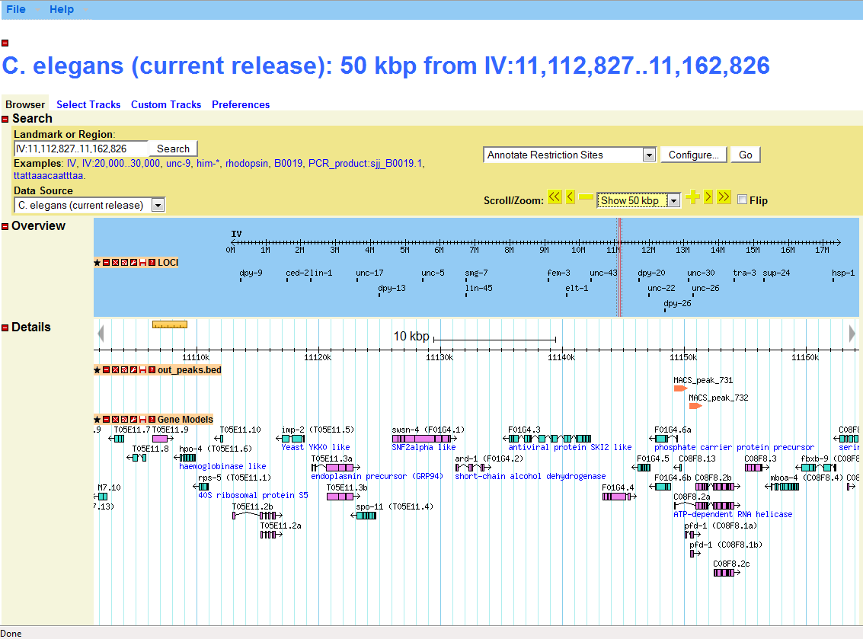
Wormbase C. elegans browser with uploaded MACS output file (from DARE)

Slide 29
Some Issues
MEME analysis of highly significant peaks from MACS and Peakseq (provided by modEncode) did not uncover the NR4A NR canonical site
NHR-6 may have unexpected binding properties (although no significant motifs were found within the peak sequences)
Incorrect peak boundaries
Develop other approaches → search peak sequences with TF binding site databases
Could this type of function be incorporated into DARE?

Slide 30
Current situation with NHR-6 project
Optimize sonication/DNA isolation procedures to generate appropriate fragment lengths for SOLiD (~250 bp)
We have been successful at anti-GFP IP and we get more DNA from our IP than we do from identically treated non-transgenic controls
Working towards tissue-specific gene expression studies (WT vs. mutant)

Slide 31
Acknowledgements
Rashika Rangaraj
Jeremy Harmson
Dr. Joohyun Kim
Dr. Brian Rowan (Mentor)
Funding by INBRE

Slide 32
DARE-NGS: Integrating Applications and CI
ChIP-Seq pipeline
: Data processing
: Databases
Mapping
Peak Calling
Mapping
With BFAST &
HPC
Other Peak Caller
Mapping
Using Cloud

Slide 33
Time Line | Oct 2011 - Dec 2011 | Jan 2012 - Mar 2012 | Apr 2012 - June 2012 | July 2012 - Sep 2012
User Community | Gissendanner Lab (LBRN PI) Ham (LSU) | Flemington (Tul/LONI) Rankinen (PBRC) All LBRN-PI Other LONI-PIs | XSEDE-GW
Devel Focus | Community Accounting with HPC | RNA-Seq pipeline | Community Engagement Flexible tool Integration | Type III service development XSEDE Resource Integration

Slide 34
Conclusions
NGS Analytics: Unique challenges
Scale of compute and data intensive
Sophistication and range of analytical requirements
DARE-based Gateway
Need for community (provided) solution
Brings Application Scientists/UI, Middleware and HPC Resource Providers together
Scalable Solution:
Application Scenarios
NGS (Type I, II, and III) and HTHP (Molecular Dynamics)
Over Infrastructure
Campus, LONI, Clouds, XSEDE and other production DCI
Challenges remain in the scalable provisioning
What are the CI challenges of NGS Analytics?
Integrated, Interoperable and Extensible Cyber-infrastructure
Tools, services and middleware

Slide 35
Acknowledgements
LBRN NIH/NCRR Grant Number P20RR016456
Sharath Maddineni and Mark Santacroos
LSU CCT
Joohyun Kim and SJ
HPCOPS NSF-OCI 0710874 and Cybertools project http://cybertools .loni.org NSF/LEQSF (2007-10)-CyberRII-01
NSF Awards Grant No. 0910812, ``FutureGrid: An Experimental, High-Performance Grid Test-bed’’ (Fox, Indiana)
SAGA team – Ole Weidner and Andre Merzky and TeraGrid/XSEDE Staff for support with deployment and integration

Slide 36
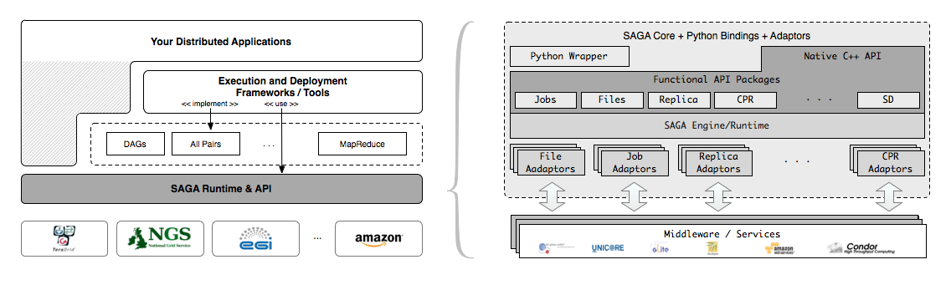
SAGA – An Overview
Simple, integrated, stable, uniform and community-standard
Simple and Stable: 80:20 restricted scope
Integrated: Similar semantics & style across primary functional areas
Uniform: Same interface for different distributed systems
The building blocks upon which to construct “consistent” higher-levels of functionality and abstractions
OGF-standard, “official” Access Layer/API of EGI, NSF-XD

Slide 37

XSEDE Technology Insertion Service

Slide 38
What is XSEDE?
XSEDE is the follow-on to TeraGrid and is the virtual organization of 17 institutions/120 FTE providing services and support for the users of NSF-OCI’s computational science resources.
CMS – coordination and management services
architecture, software integration, systems engineering, operations, allocations, project mgmt
ECSS – extended collaborative support services
TEOS – training, education, and outreach services
5-year award started July 1, 2011

